Slide 1
campus map publishing system Prototype Project
UVM Transportation and Parking Services

Slide 2
agenda
Review Project History (8 minutes)
Project Status Update (14 minutes)
Plan for Future (8 minutes)

Slide 3
Map Project History

Slide 4
project timeline
June 14, 2012
Purpose and Scope
S:\afs\TPS\TPS\2012\dpepper\20120601_projectManagement\output\project_01_purposeAndScope_201206151215.pdf
Major Goals Outlined:
Store…
map data in database
assets in “library”
Prepare to rapidly publish custom map products (w/data subsets):
Parking Lots by Permit Type
Residential Buildings by Permit Type
Bus Stops by Route
Allow combinations:
For example, Blue Permit: Parking Lots, Residences, and Bus Routes

Slide 5
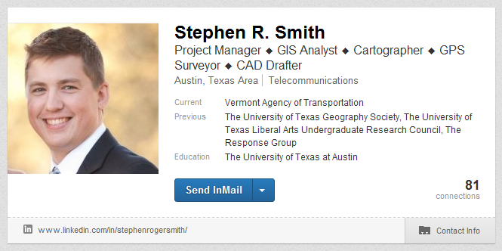
project timeline
August 9, 2012
Interviewed GIS Analyst
Stephen R. Smith
As Follow-up to meeting:
Researched UVM contracting
process
Initiated laptop procurement
Contacted Campus Planning to request data
Project slowed/delayed due to…
Holidays, etc.
Laptop procurement delays
Assumption that hiring an expert at the beginning of the project would not have been cost-effective

Slide 6
project timeline
January 9th, 2013
Received ArcGIS Polygons for
Redstone Campus:
Parking Lots
Buildings
Roads
Received tabular data in Excel/CSV:
Parking Lots
Buildings
Roads

Slide 7
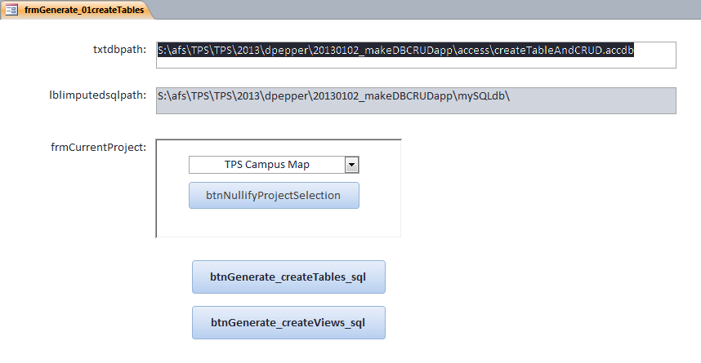
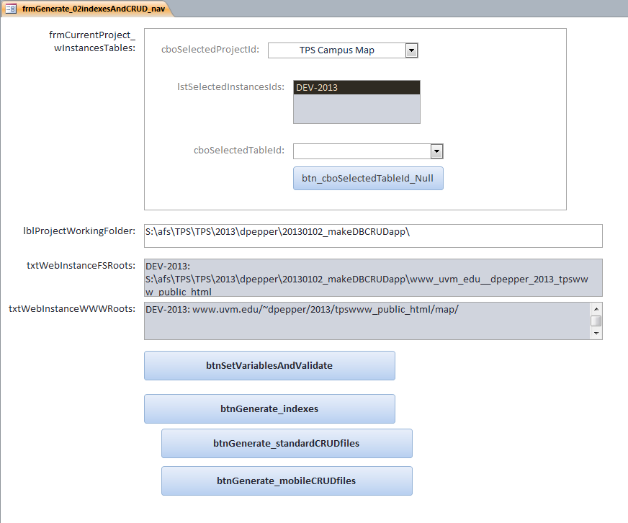
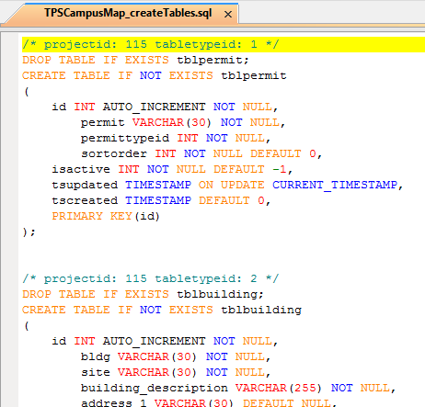
project timeline
January 15th, 2013
Began “DB CRUD” Application
“CRUD” stands for “Create, Read, Update, and Delete”
basic SQL DML operations
Application’s main features
Model database designs with standardized features
IDs, timestamps, data type design patterns (e.g. FK-LU)
Generate “Create Table”, “Create View” scripts

Slide 8
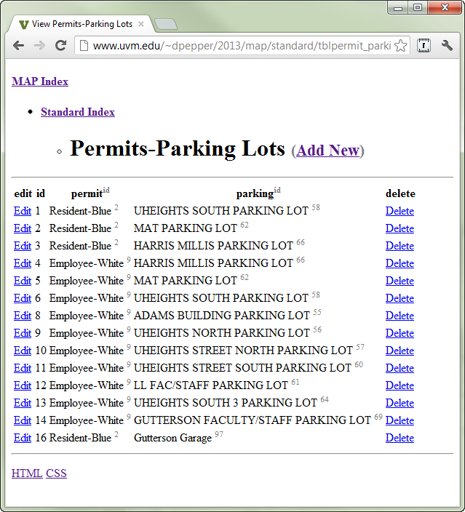
project timeline (January 15th, 2013 continued)
January 15th, 2013 (continued)
“DB CRUD” Application (continued)
Application’s main features (continued)
Generate standard web interfaces to database
Indexes: application, context
CRUD files
mixture of PHP, Javascript, HTML, CSS
Allows rapid development of web database applications
Maintains data in enterprise database
MySQL Server: webdb.uvm.edu,
Accessible to both web and desktop
Ended “DB CRUD” App development mid-June, 2013

Slide 9
project timeline
June 26th, 2013
Began process of building Campus Map Publishing System Prototype
Geospatial Specialist Teoman “Teo” Korkmaz joined project working on the design of the map prototype in ArcGIS
focusing on integrating database assets and ArcGIS assets
David Pepper focusing on rest of project
working on architecture, storage layer and project management

Slide 10
TPS CAmpus Map Publishing System

Slide 11



TPS CAmpus Map Publishing System
Campus Map Publishing System Prototype
Storage design in “DB CRUD” generator system
Data in MySQL server: webdb.uvm.edu,
Database: DPEPPER_1 (dev)
Web interfaces on dev website:
http://www.uvm.edu/~dpepper/2013/map/standard/index.htm
Access database linked to map database tables
in MySQL
tpsCampusMap.accdb
S:\afs\TPS\TPS\2013\dpepper\20130626_makeCampusTPmapPrototype\
tpsCampusMap.accdb
ArcGIS project “CampusTPmap_prototype”
Located on “TPSGraphics” workstation at:
C:\2013\dpepper\20130703_makeCampusTPmapPrototype\
CampusTPmap_prototype.mxd

Slide 12

TPS CAmpus Map Publishing System
Architecture of an ArcGIS Project
Layers like a hamburger
Assets linked to location on earth
Basic ArcGIS asset types:
Polygons (parking lots, buildings)
Points (locations of bus stops, bike racks)
Lines (bus routes)

Slide 13
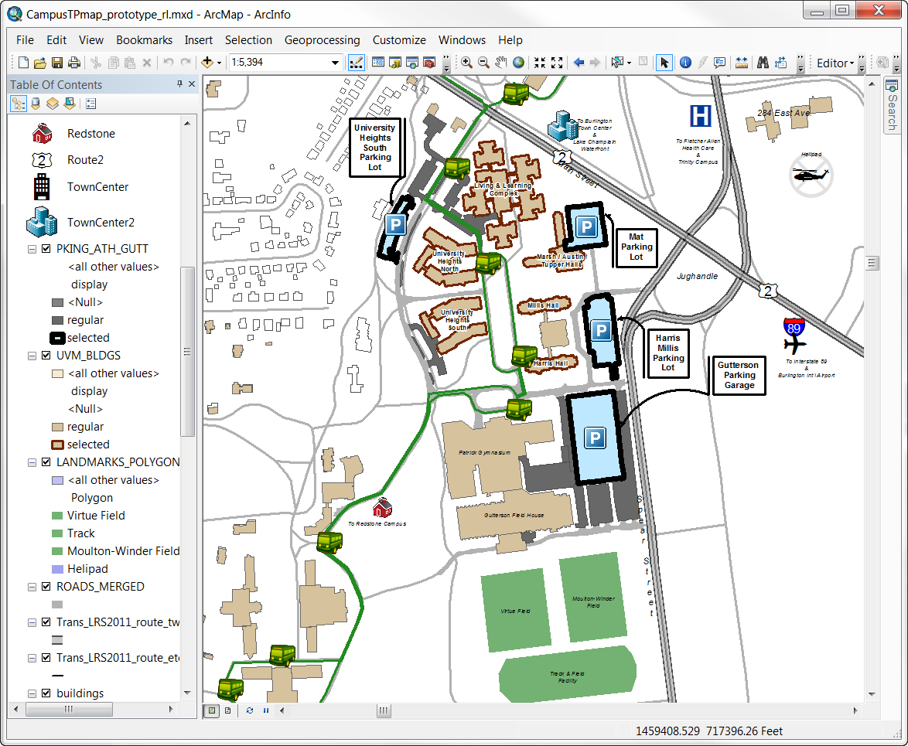
TPS CAmpus Map Publishing System
How the ArcGIS Project is Designed (top-bottom)
Points of Interest
Bus Layer
Stop Points
Route Lines Parking Lots
Parking Lots
dynamically formatted (“regular” or “selected”) according to Selected Permit
Buildings
dynamically formatted (“regular” or “selected”)
Background Assets
Roads
Base map

Slide 14

TPS CAmpus Map Publishing System
Map Layout Design Choices
North is up
a.k.a. “phone-view”
UVM divided into
4 sub-campuses
Each is a separate map page
fully formatted (i.e. legend, title, etc.)
Formatted for printing
In Color, but designed for
B/W printing
8.5” x 11”

Slide 15
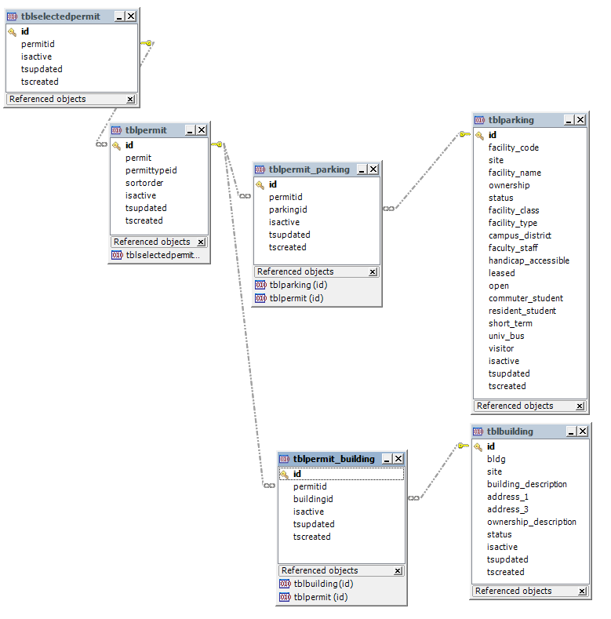
TPS CAmpus Map Publishing System
Map Data Design
tblselectedpermit data temporarily establishes scope of deliverable by storing selected permit IDs
M-M tables permanently store relationships between permits and parking lots and buildings
tblpermit_parking
tblpermit_building

Slide 16
TPS CAmpus Map Publishing System
Data Interfaces
Indexes
Create (“Add”)
Read (a.k.a. “Select”/”View”)
Update (“Edit”)
Delete

Slide 17
future plans

Slide 18
Future plans
Finished…
Maps by Permit Type (Resident-Blue, Employee-White)
Next?...
ESRI-to-Google Workflow
More Specific Use-cases
Present Project Results to Stakeholders
TPS
Campus Planning
???
Consider Project to Build Full System
Benefits
Customized Deliverables for Stakeholders
Revenue?
Costs
Support
ü
ü
ü

Slide 19
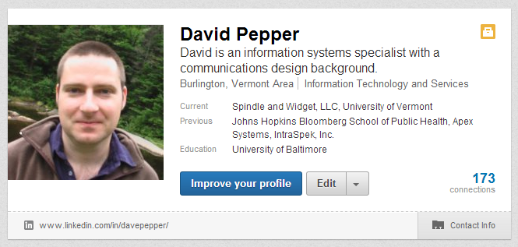
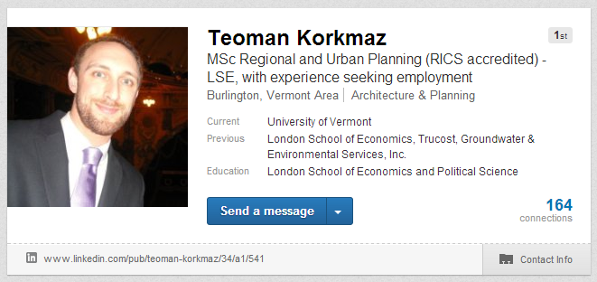
Future plans
David Pepper
davidpepperit@gmail.com
Teoman Korkmaz
tqk5017@gmail.com

